Slide 1

Installation Guide
Wilson Gan & Philip Kim

Slide 2
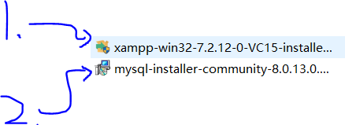
Welcome to use this program
First, please export the zip file
Second, Please install the Xmapp install file first.
Third, Please install the Mysql install file.

Slide 3
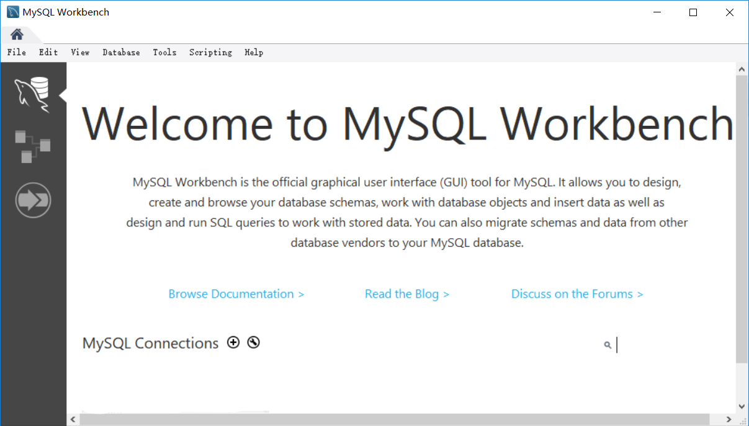
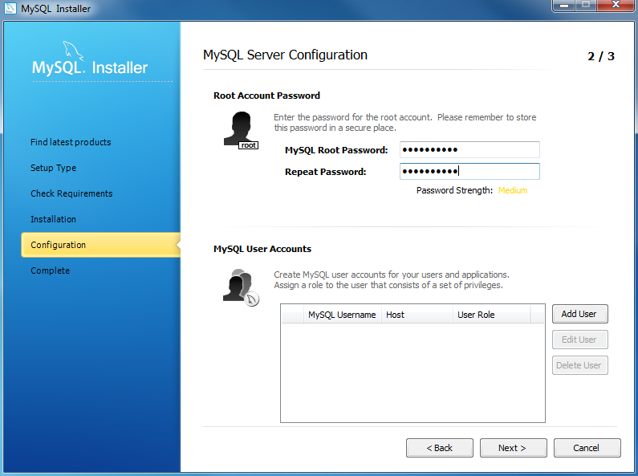
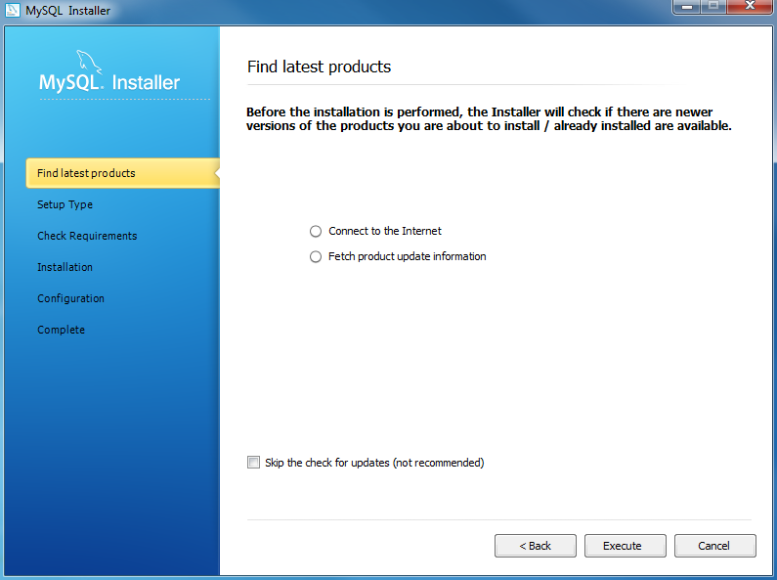
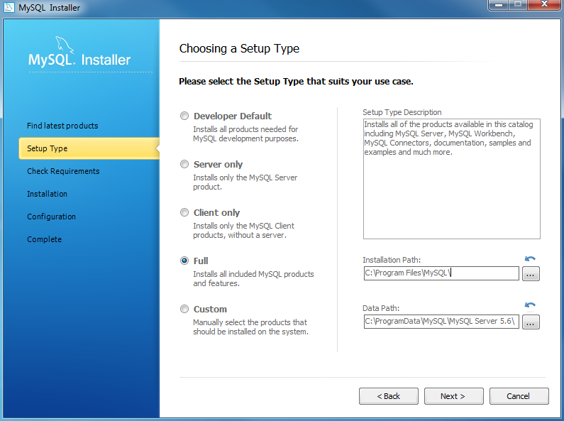
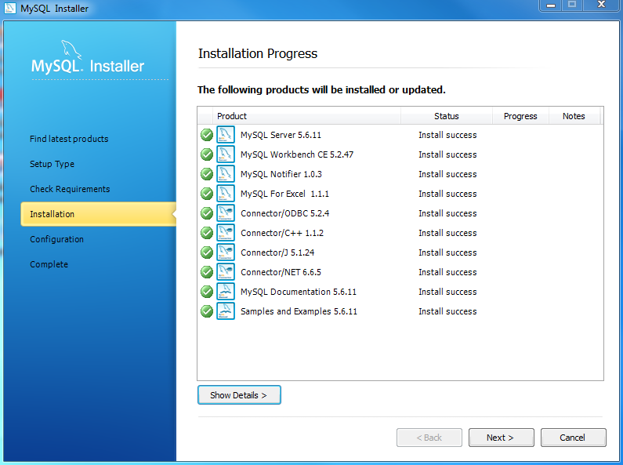
Mysql Install
First, you will see the install page like above picture.
Second, Please select Full setting when you need to set up your use case
Third, Make sure all the Sql file install success.
Fourth, Make sure you set up the username and password of mysql (Please don’t forget it, if user forget it, it may lost all the data).
At the end, you should see the launch window like it.

Slide 4
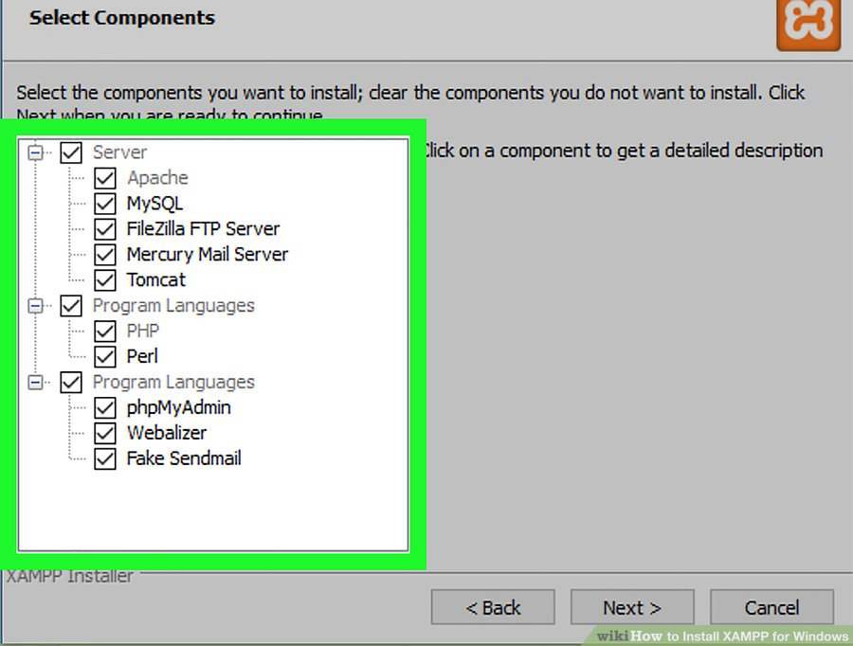
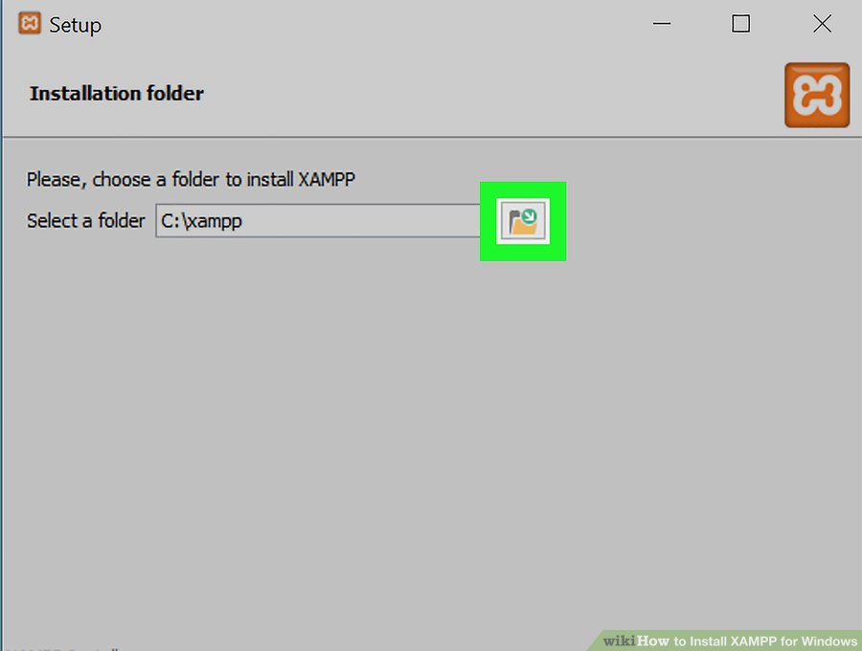
Xmapp Install
When user try to install it, please remember to select all the case in this page, make sure Xampp work.
You can set up your install location in the page .
After you set up your location, please put the “myphp” folder into the Xampp/htdocs/ and paste the folder at there.

Slide 5
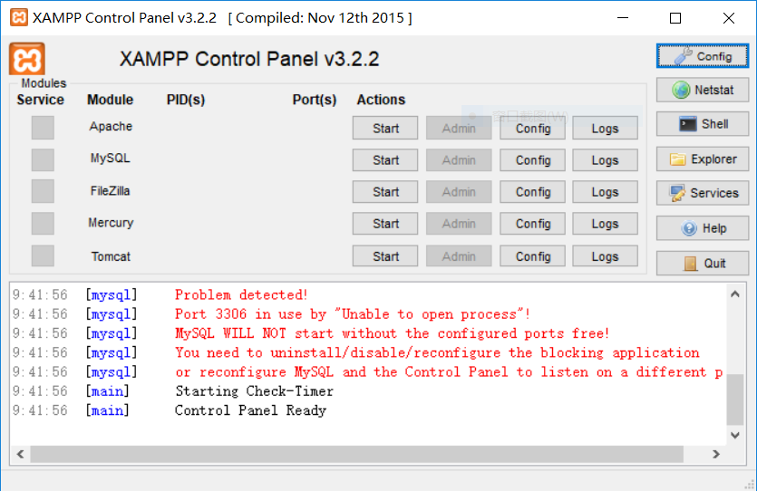
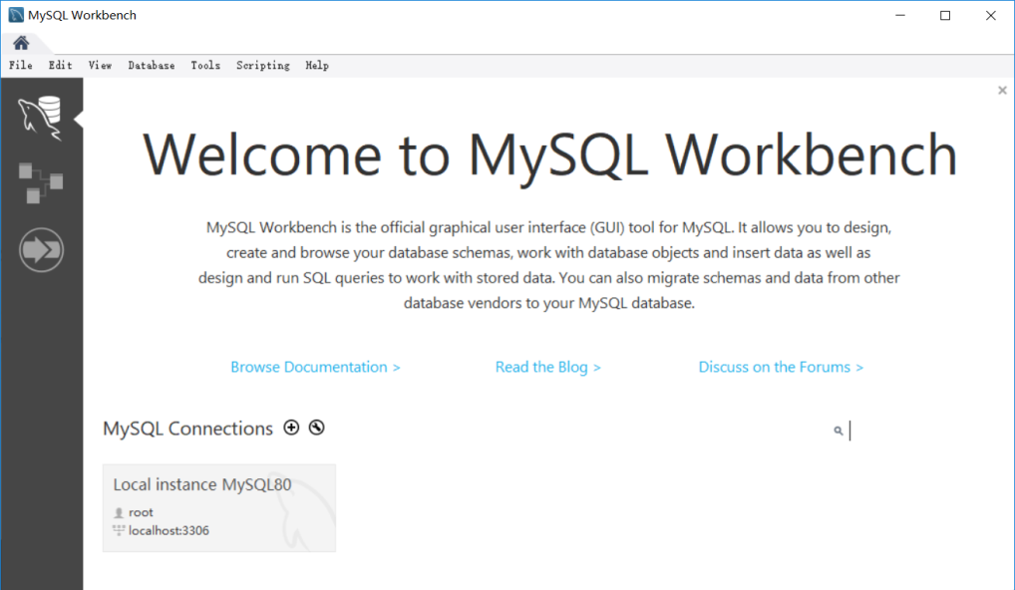
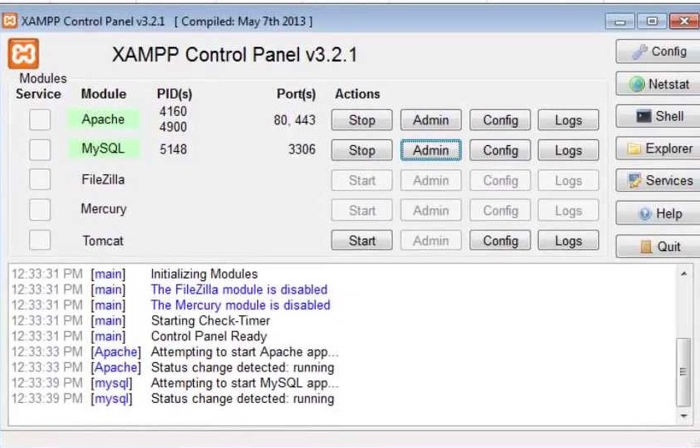
Xampp setting
When user finish the Xampp and mysql install, user should click the start button of Apache and start button of mysql one by one.
When you run it success, you should see it like the picture.
And than, in your sql launch, you will see a new local database.

Slide 6
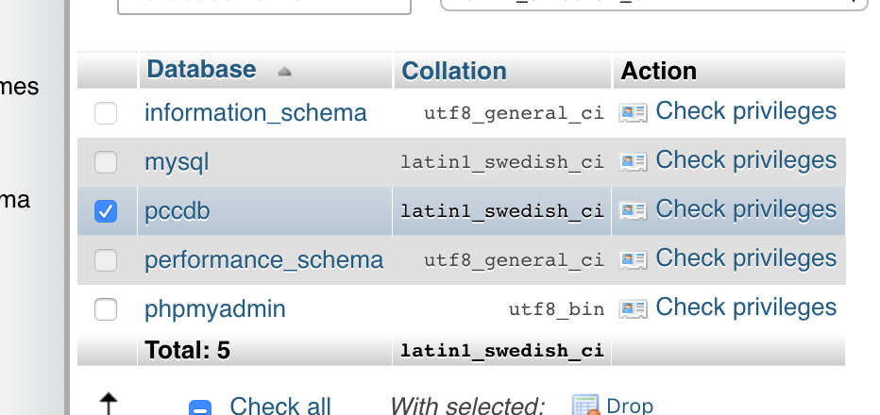
MyPhpadmin
After you set up all the thing, you can use a chorine and enter a websire.
http://localhost/phpmyadmin/
And you should see the main page of data base.(without the pccdb)

Slide 7
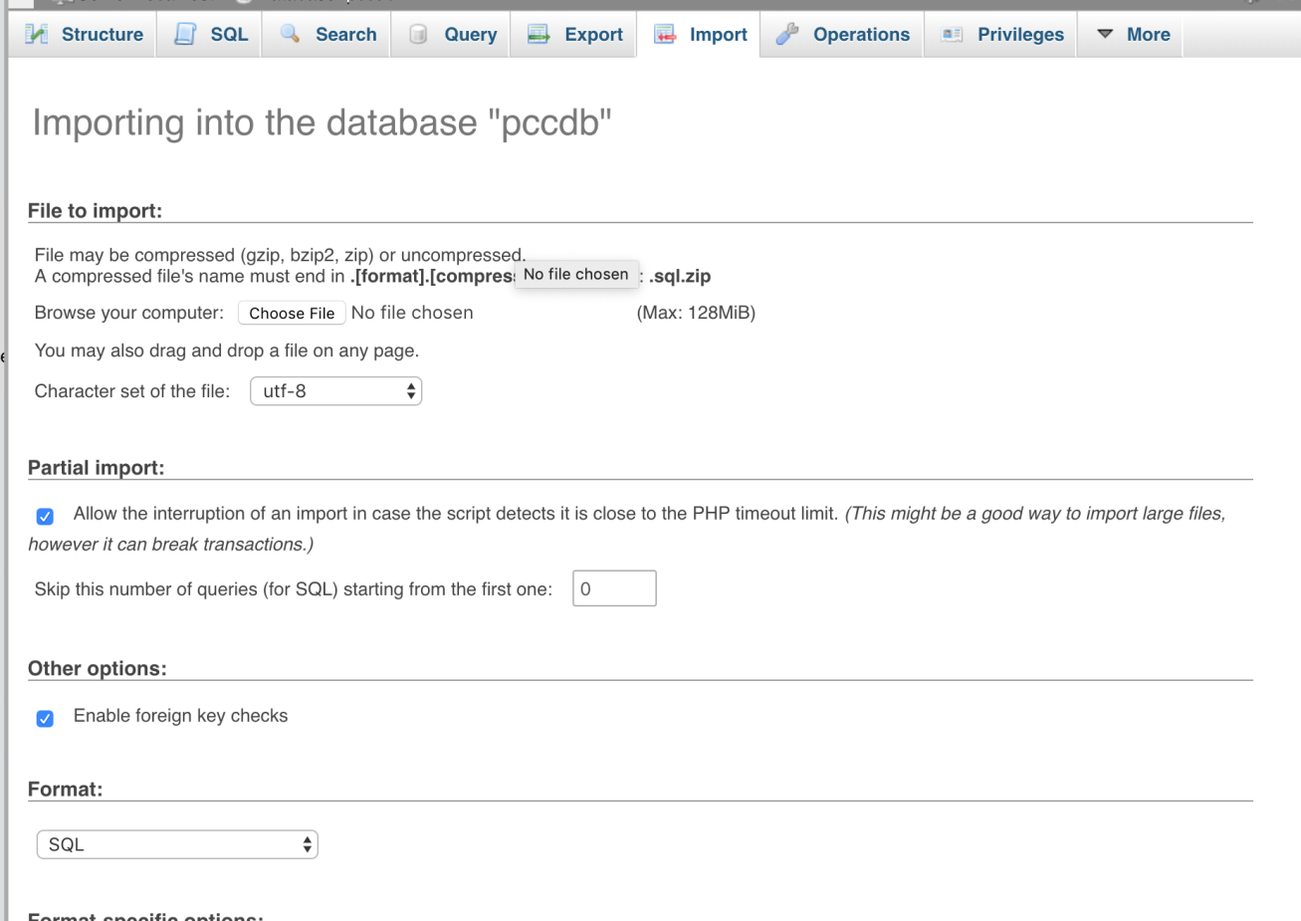

Import the database
When you can see the main page of database.
First,create a empty database which name”pccdb”
Click the Import button to import your sql file which in the folder.

Slide 8
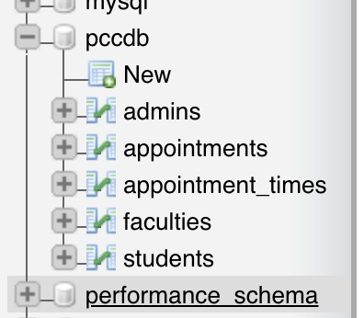
Database
When you finish the import, you can see the database name: pccdb.
In that database, you can see there are many table inside it.
1. Admins – the login inforation of admin
2. Appointment – the appointment information of all the student
3. Appontment_times - the information of staff available time.
4. Faculties – all the information about the faculties and it will show it to all student.
5. Student – student log in and detail information.

Slide 9
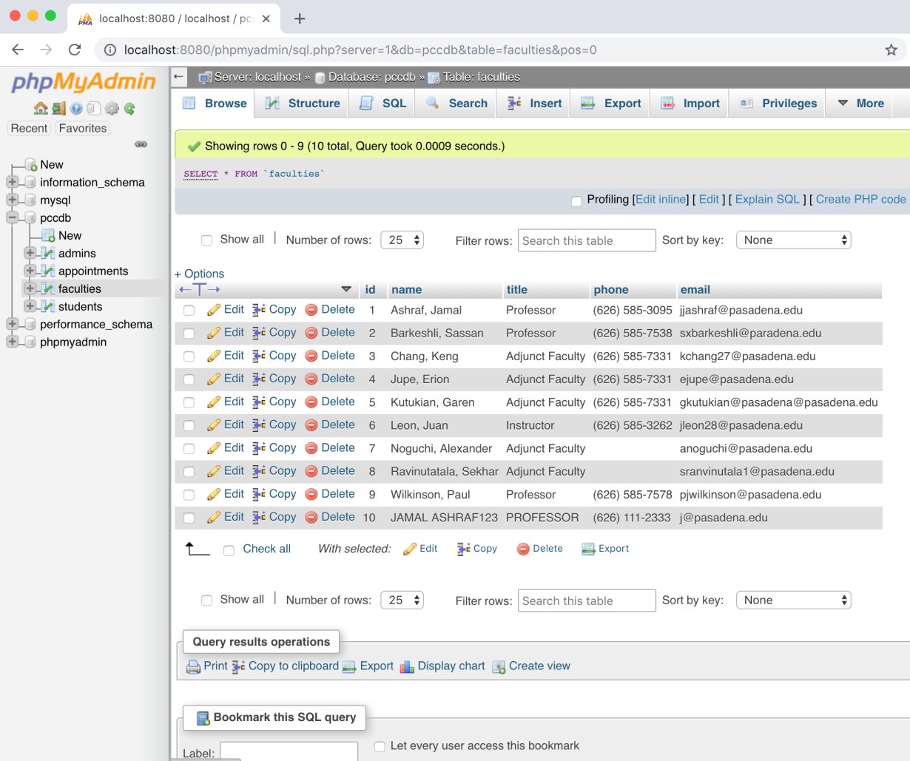
Faculty information
When user click the faculty table, you can see there are some information about the staff.
You can edit and delete some information in the database (We don’t suggest to do that).

Slide 10
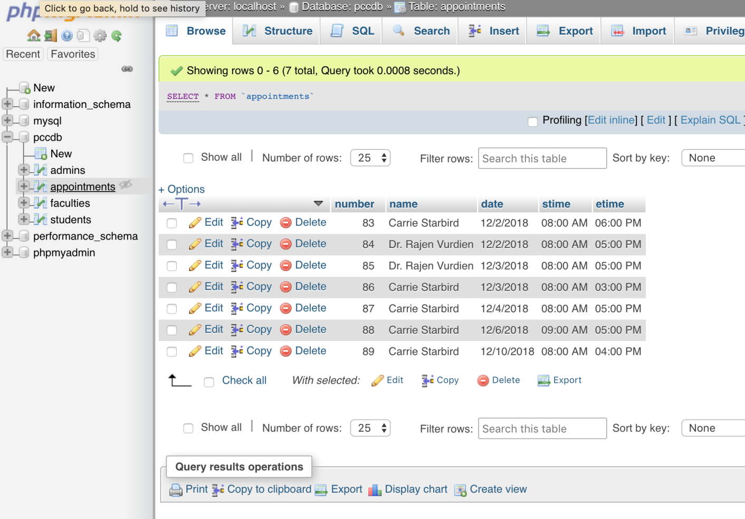
Appointment data
There is the appointment data page.
You can check all the appointment and the person who student want to meet in here.

Slide 11
Student Information Data
In the student information part.
Student ID and Name is constant when they register.
Student can change their username, password, major, email, and phone number in their app page.

Slide 12
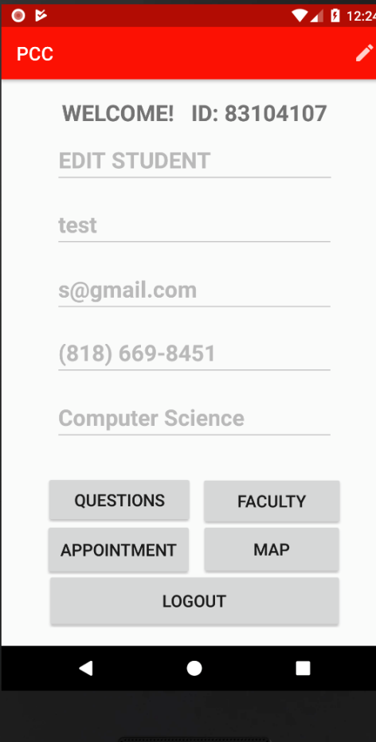
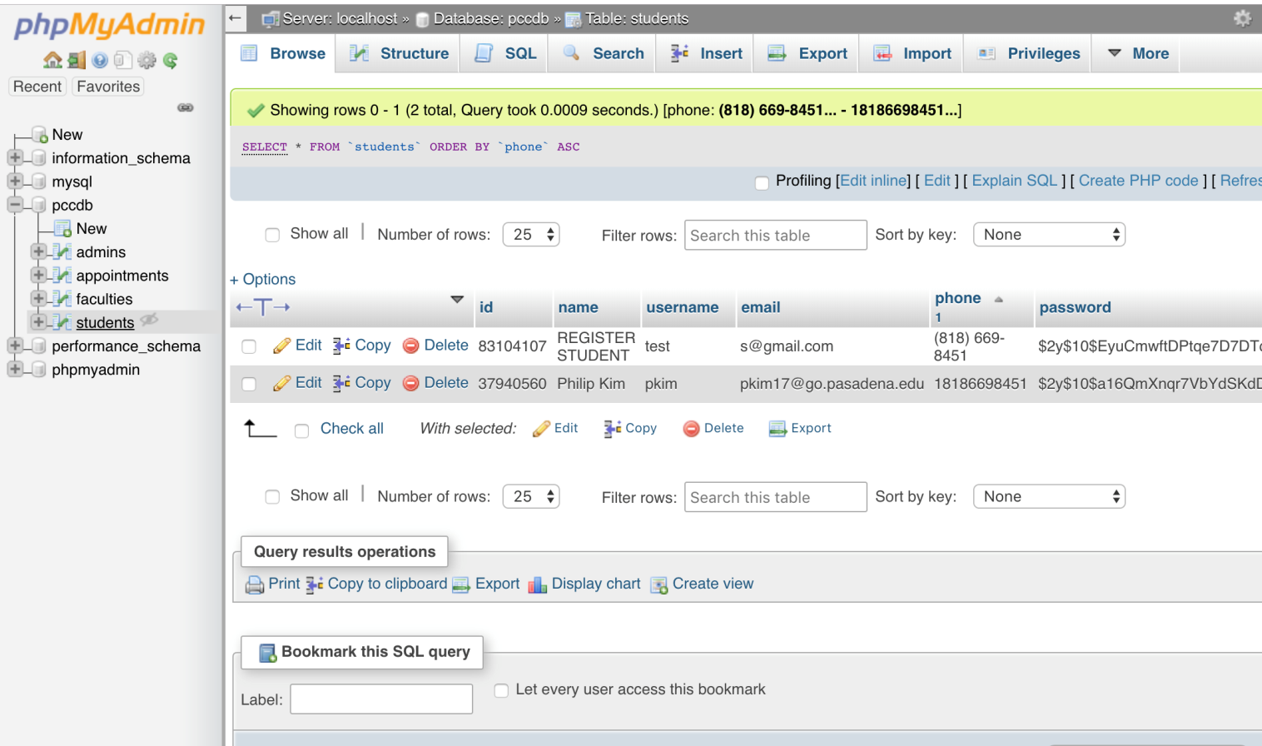
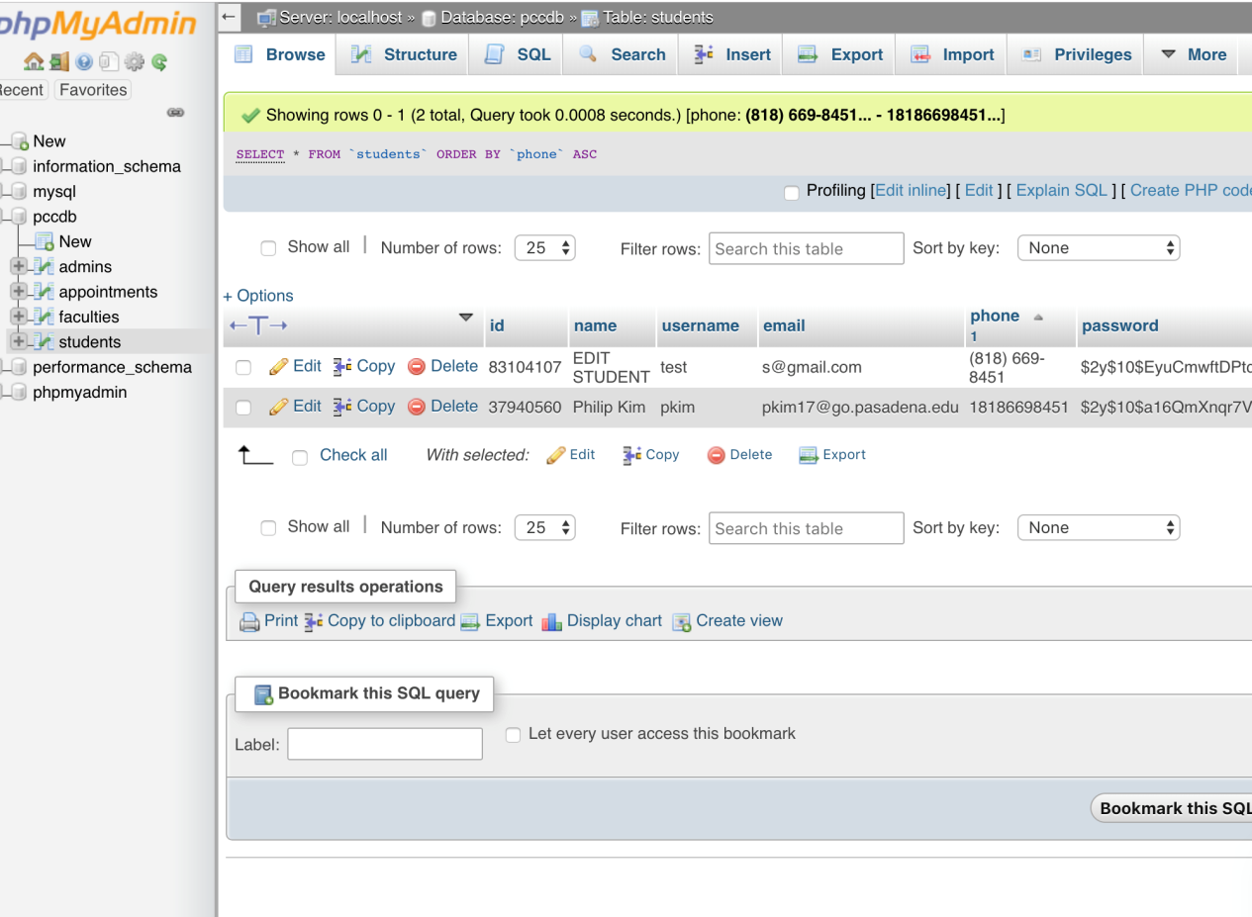
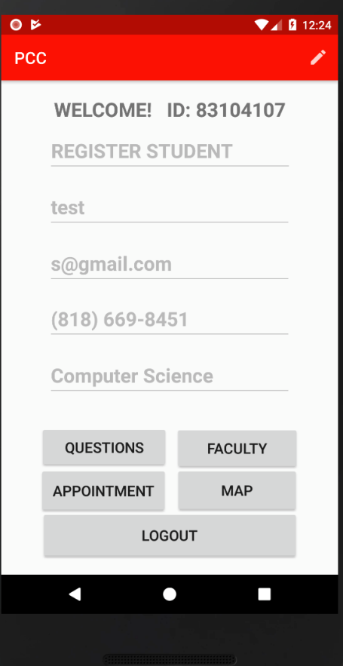
Student data
This is the student data.
It will update the information if students login their app.

Slide 13
Admin Information Data
In the Admin Information part.
Admins’ ID and name is constant after they register in the app(may change in the database)
Admins can change their username and password in the app

Slide 14
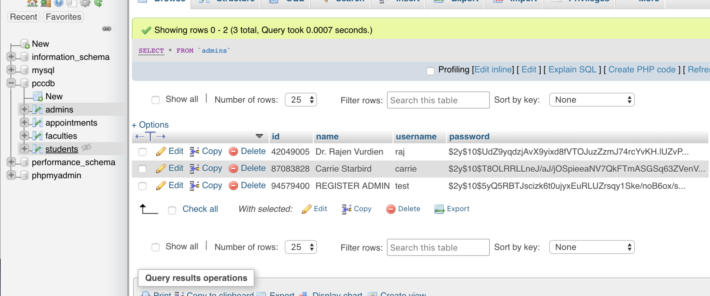
Admin data
This is the admin data.
Username and password will be update if user change it.

Slide 15
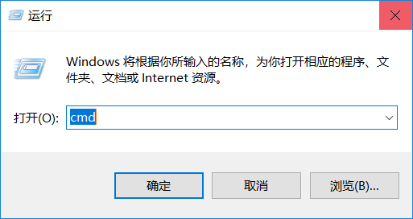
Set up your local IP Adress (part 1)
First, click your main menu of computer and search “Run”, and run it.
Enter “cmd” and click ok of that window.

Slide 16
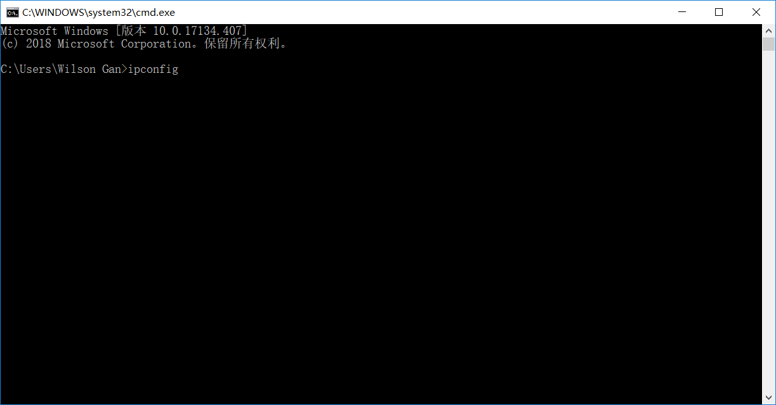
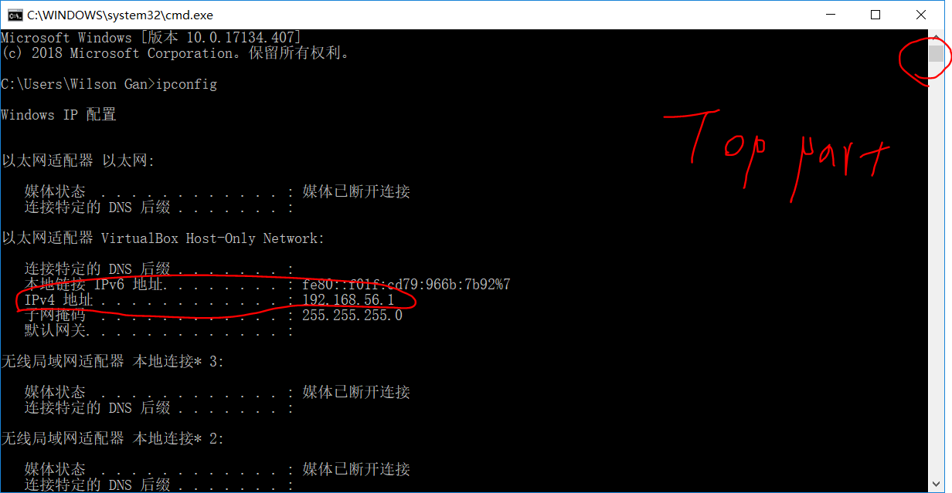
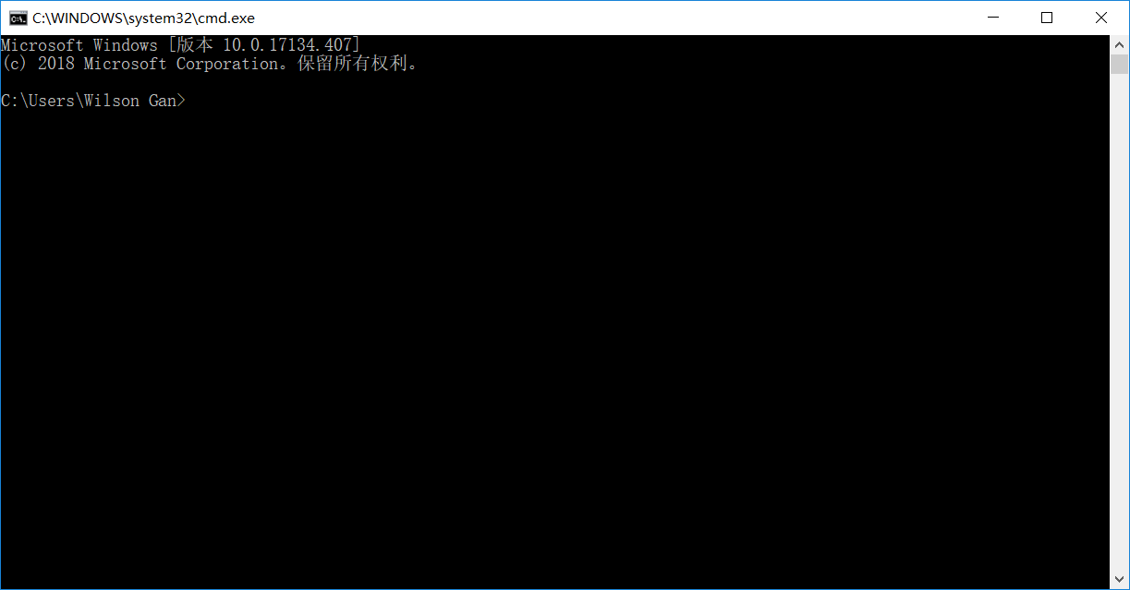
Set up your local IP Adress (part 2)
When you finish the step above. You will see a new black window.
And than enter “ipconfig” and than enter it.
So you can see a lot of thing, go to the top part and look for the first part of “IPv4 adress”
Copy the number at the same line(Ex: 192.168.56.1).

Slide 17
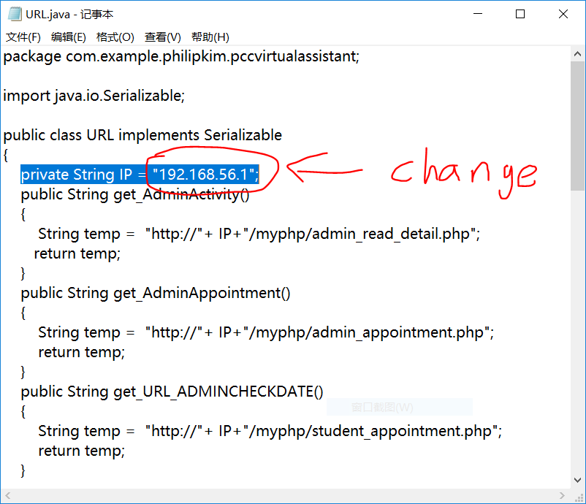

Set up your local IP Adress (part 3)
After you copy the IP address, go back to the folder which you export, find a URL.java file.
Open the file with TXT software. (right click the file and select “open with” and use “Text” to open”
In the file, you can see there is one line code like it. (private String IP = "192.168.56.1";)
Change the number of that line to your IP address

Slide 18
Set up your local IP Adress (part 4)
Save the file after your edit and copy the whole file and put in a new place.
The location should be : “You zip file export location”\PCCVirtualAssistant\app\src\main\java\com\example\philipkim\pccvirtualassistant
Replace the same name file and you set up is done.

Slide 19
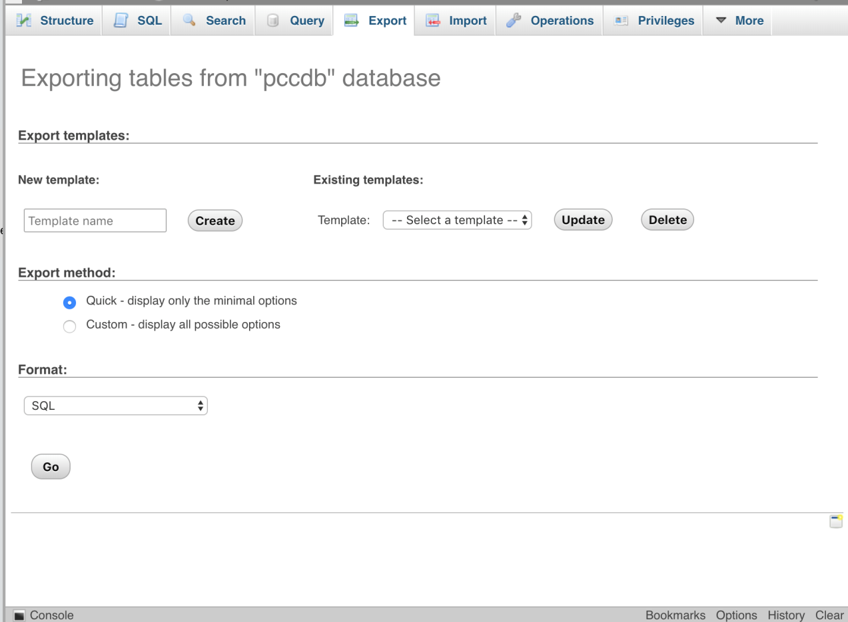
Export Database
Because this is a local base, if you want to transfer to other computer, you need to export the database create a sql file, so other can import it.
Go to the main page of Database and than click the export button. Create a temp name and click the GO button, so you can create it.

Slide 20

Apk install
After set up all of it, Manager can sent out the apk file to the students and admins who need to use this program and install it to the phone

Slide 21
Thank you for your use

